Slide 1
Introduction to OOP

Slide 2
Objectives
At the end of this lecture, you will be able to :
Understand Object-Oriented approach to programming
Understand what is an Object
Understand what is a Class
Create an Object from a Class
Interpret a simple Class Diagram
Access data and methods

Slide 3
Topics
Object-Oriented approach to programming
Objects
Classes
Creating an Object from a Class
Class Diagram fundamentals
Accessing data in Object
Accessing methods in Object

Slide 4
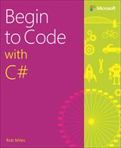
Reading Reference
Begin to Code with C#
By Rob Miles

Slide 5
Object-Oriented Programming /1..
Why Objects?

Slide 6

Object-Oriented Programming /2..
At the end of the day...
computers just manipulate 0’s and 1’s
But binary is hard (for humans) to work with

Slide 7

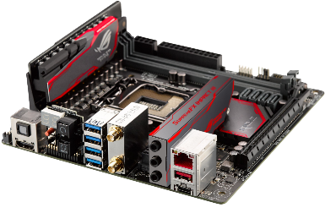
Object-Oriented Programming /3..
Towards a higher level of abstraction
??
OO Languages (C++, Java, C#, Swift, Kotlin & etc)
High-level languages
Procedural languages (C, Python, Pascal & etc)
Assembly Languages
Low-level languages
Binary Code (machine language)

Slide 8
Object-Oriented Programming /..4
There are always trade-offs
High-level languages
simpler to write & understand
more library support, data structures
Low-level languages
closer to hardware
more efficient (but also dangerous!)

Slide 9
What are Objects?

Slide 10
What are Objects? /1..
An object is an entity in the real world that can be distinctly identified
e.g. a circle, a book, a customer, a bank account, an event
Each object has:
characteristics
responsibilities (or required behaviors)

Slide 11
What are Objects? /2..
Example,
Problem Design and build a computer soccer game
Object Soccer player
Characteristics Position, height, weight, salary, number of goals
Responsibilities Pass the ball, shoot, dash forward, dash backward, block player, etc.

Slide 12
What are Objects? /..3
Another example,
Problem Bike Sharing Application
Write a program that allow users to register a bike sharing portal. The user can locate nearby bikes, reserve a bike, unlock a bike and pay for the duration’s ride using credit points.
Object/s ???
Characteristics ???
Responsibilities ???

Slide 13
What are Classes?

Slide 14


What are Classes? /1..
Have you seen a cookie-cutter?
A class is like a “cookie-cutter”; it defines the shape of objects
How many cookies can you make with 1 cookie-cutter?
Objects are like cookies; they are instances of the class

Slide 15
What are Classes? /2..
Another example,
Student (Class)
Peter, John & Tom (Objects – instances of Student)

Slide 16
What are Classes? /3..
Question:
Tom wanted to create a Student Class in C#, what do you think he needs? Discuss.
Well, a student usually has a Name, ID & etc.
What can this Student Class do?
Allow a program to write a name
Allow a program to read the name

Slide 17
What are Classes? /4..
Defining Class in C#,
Name of a Class
Field(s)
Property or Properties
Constructor(s)
Method(s)
Characteristics
Responsibilities

Slide 18
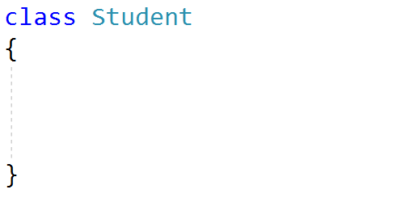
What are Classes? /5..
Defining Class in C#,
Name of a Class
Fields
Property or Properties
Constructor(s)
Method(s)
Lower case
Capitalized

Slide 19
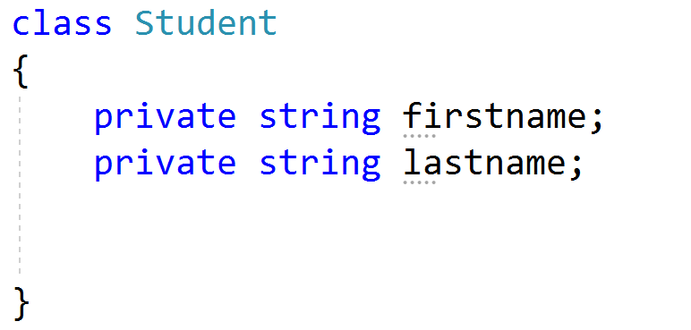
What are Classes? /6..
Defining Class in C#,
Name of a Class
Field(s)
Property or Properties
Constructor(s)
Method(s)
Note: ignore encapsulation as we’ll cover this in the next lecture.
Type: e.g. int, bool, double & string
(lowercase)

Slide 20
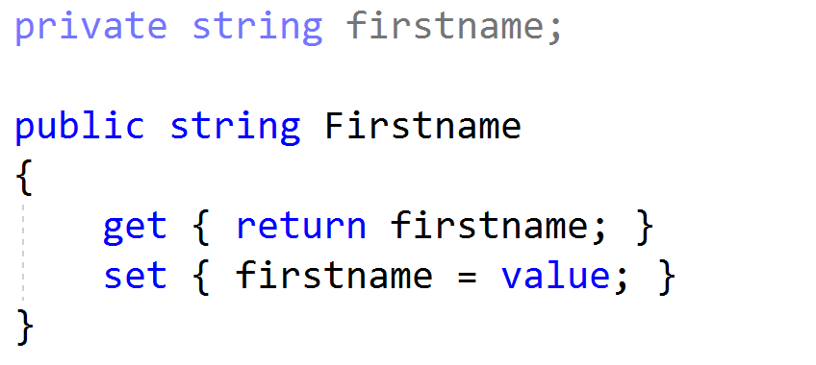
What are Classes? /7..
Defining Class in C#,
Name of a Class
Fields
Property or Properties
Constructor(s)
Method(s)
Property is used to read/write information into the various fields.
lowercase
uppercase
Note: ignore encapsulation as we’ll cover this in the next lecture.

Slide 21
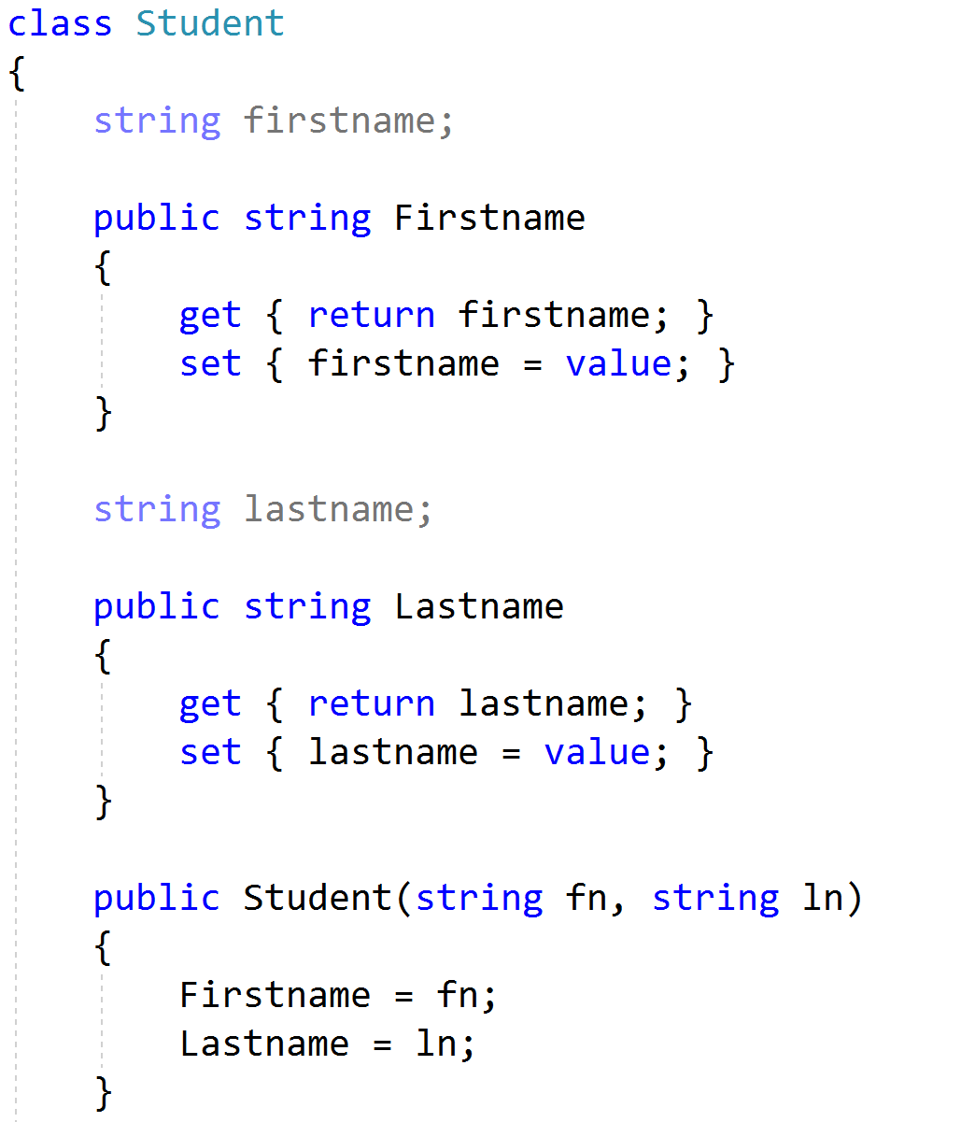
What are Classes? /8..
Defining Class in C#,
Name of a Class
Field(s)
Property or Properties
Constructor(s)
Method(s)
Same name
lowercase

Slide 22
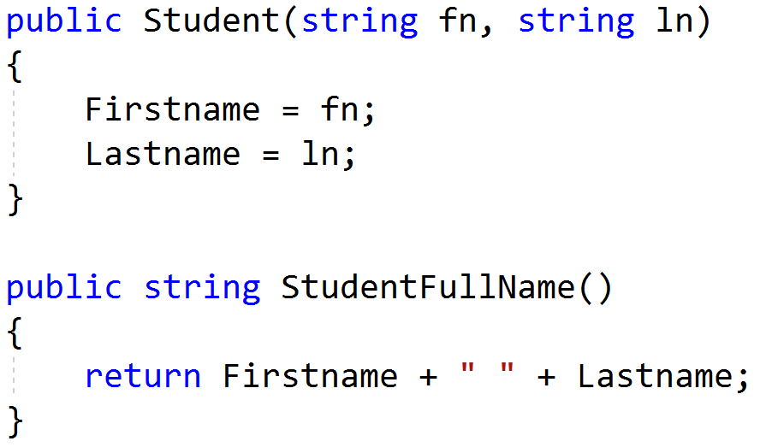
What are Classes? /4..
Defining Class in C#,
Name of a Class
Field(s)
Property or Properties
Constructor(s)
Method(s)
Capitalized
Note: Commonly known as function in other programming language

Slide 23
How to create Objects
from a Class?

Slide 24
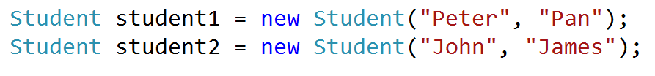
Creating an Object from a Class
To create an object from a class, invoke a constructor of the class using the new operator as follows
ClassName ObjectName = new ClassName(argument…);
Student1 object and student2 object are instances of Student Class

Slide 25
Representing a Class with
a Diagram

Slide 26
Class Diagram Fundamentals /1..
A Class can be represented using the Class Element diagram in the UML notation as shown below:
Class Name
attributes1 attributes2 . . .
behavior1 behavior2 . . . . . .
Note: attributes also known as fields in C#.

Slide 27
Class Diagram Fundamentals /2..
Example 1,
Product | Class Name
-code:int -name:string -price:double | Attributes/ Characteristics
+Product(int,string,double) +CalculateGST():double | Behaviors/ Responsibilities
- private (not accessible by other classes, only accessible by it’s own methods)
+ public (accessible by other classes)

Slide 28
Class Diagram Fundamentals /3..
Example 2,
BankAccount
-accountNumber:string -accountName:string -balance:double
+BankAccount(string,string,double) +Deposit(double) +Withdraw(double) +CalculateInterest():double
Class Name
Attributes/
Characteristics
Behaviors/
Responsibilities

Slide 29
Class Diagram Fundamentals /..4
Example 3,
Person | Class Name
-name:string -tel:string | Attributes/ Characteristics
+Person(string,string) | Behaviors/ Responsibilities

Slide 30
Accessing data in Object
Data
can be accessed via Property
e.g. Product p1 = new Product(1001, "iPhoneX", 1088.00);
double oldPrice = p1.Price; // read (get) value
p1.Price = 888.00; // update (set) value

Slide 31
Accessing methods in Object
Methods
can be accessed directly
accessed using the dot (.) operator
e.g. double gst = p1.CalculateGST();
string s = student1.GetFullName();

Slide 32
Summary
Object-Oriented approach to programming
Objects
Classes
Creating an Object from a Class
Class Diagram fundamentals
Accessing data in Object
Accessing methods in Object

